Slide 1



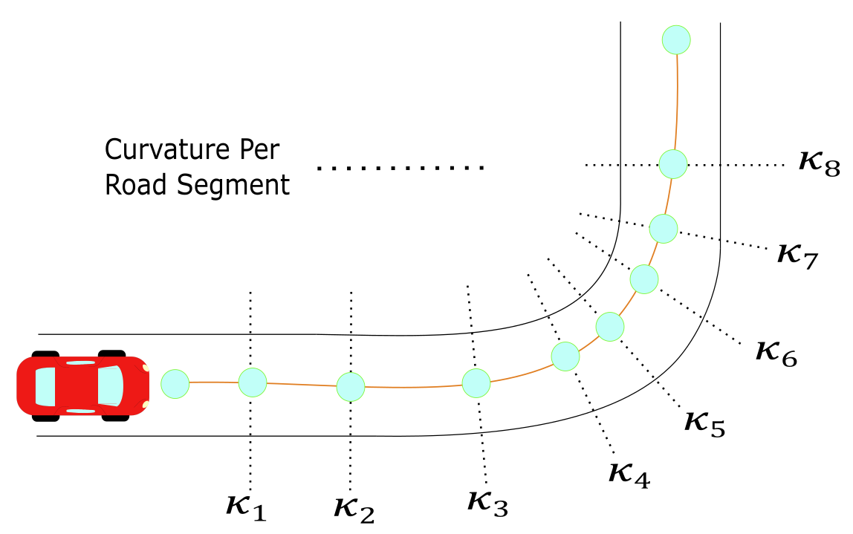
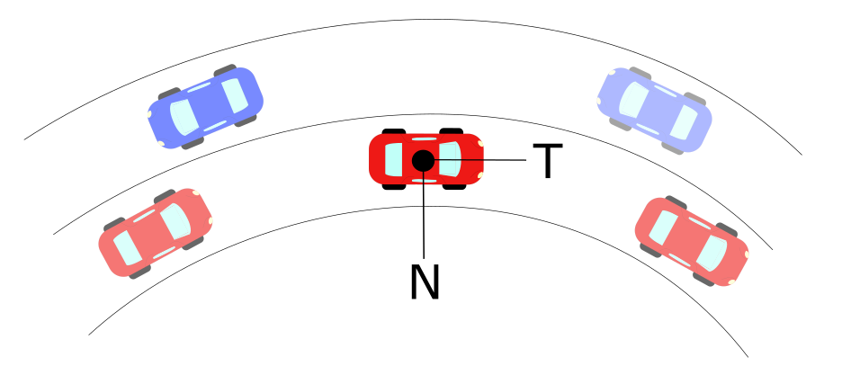
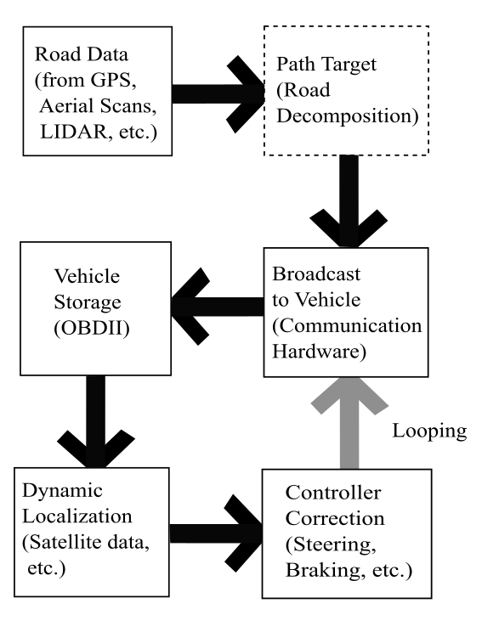
Road Curvature Decomposition for Autonomous Guidance
Ricardo Jacome, Mechanical Engineering Graduate Research Assistant, University of Nebraska -Lincoln
Jacome, Sweigard, Stolle
OBJECTIVE
DESIGN CRITERIA
COMPONENT TESTING
Develop a method for discretizing geospatial data and providing path guidance for autonomous vehicles.
Objectives & Criteria
Impact conditions determined by length of need
4 dynamic bogie tests were conducted on the Dragnet Vehicle Arresting Barrier
BACKGROUND
Vehicle autonomy has been touted as the future of transportation, but there are significant challenges which remain to be addressed.
Tremendous growth has been achieved in “Advanced Driver Assistance Systems”
Need low-cost, crashworthy solution functional for many impact conditions and with narrow footprint
Example: bridge adjacent to intersection
Initial Configuration
Energy Absorber Failure
METHODOLOGY
CONCLUSIONS & FUTURE WORK
Net attenuator selected for testing and stopped a 5,259-lb bogie vehicle traveling at roughly 60 mph in 43 ft or less
Component testing suggested design would work under variety of impact conditions, speeds, and angles, and was versatile for installation
Design must be paired with other crashworthy crash cushion (in development) – future work
Review existing systems and applications
Develop narrow-footprint concepts
Component test & measure reactions
ACKNOWLEDGMENTS: MwRSF’s Outdoor Proving Grounds Manager, Test Technicians, and Students for conducting tests

